Slide 1
Course Overview
CSCI 601.771: Self-supervised Statistical Models
https://self-supervised.cs.jhu.edu
Notes:
Welcome to … .
My name is …

Slide 2
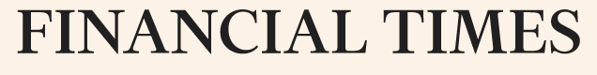
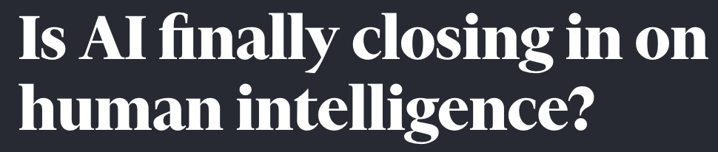

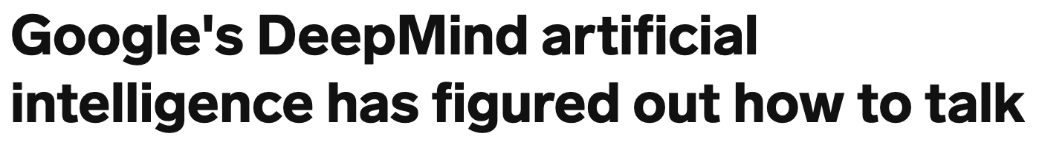
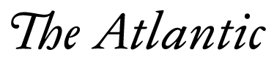
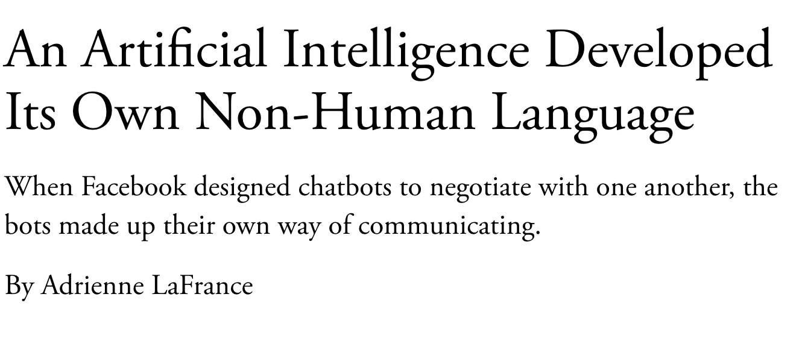
Popular Media: AI is Solved!!
Self-Supervised Models
Notes:
As I am sure you all know, the past few years has witnessed a lot of buzzwords around AI’s progress: So much so that some people got the impression that AI systems are closing in on human intelligence and …
The backbone of all these news is the recent developments in “self-supervised models”,

Slide 3
Self-Supervised Models
Notes:
…. which I am going to spend a few minutes to define.

Slide 4
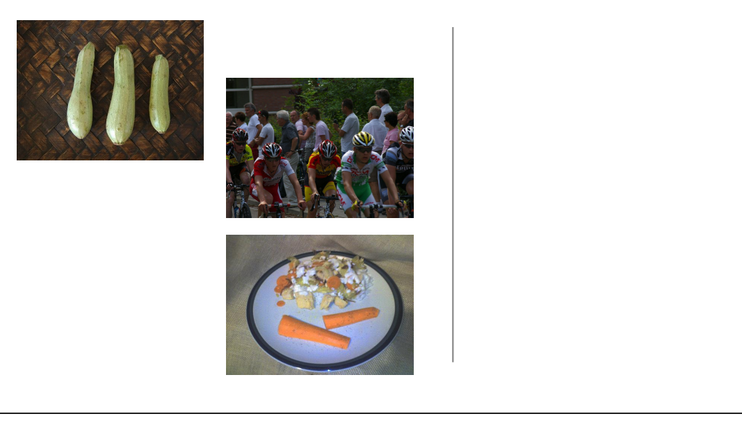
Self-Supervision
[Slide from Colin Raffel]
Notes:
Let's start with a example. Let's say I go out into the world and collect a dataset of natural images. So, first I get this picture of some cyclists…

Slide 5
Self-Supervision
[Slide from Colin Raffel]
Notes:
then a few more photos

Slide 6
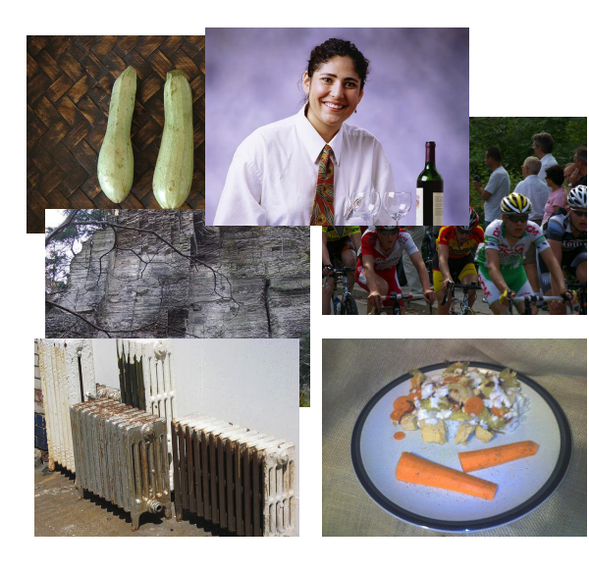
Self-Supervision
[Slide from Colin Raffel]
Notes:
And then a few more photos

Slide 7
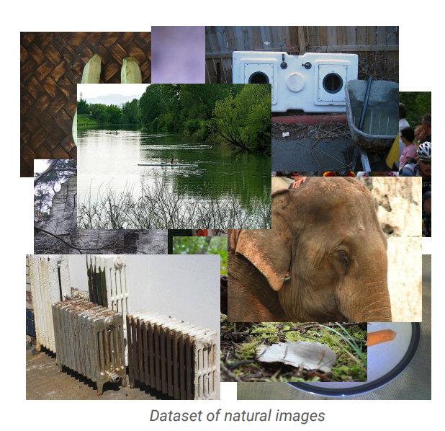
Self-Supervision
[Slide from Colin Raffel]
Notes:
And eventually I have a large collection of natural images.
One can assume that these images are samples from some true distribution - the distribution of natural images.
The goal is to take this training set and learn a model which approximates this true distribution.
That is, I hope to be able to draw new samples from my model which appear like real natural images, but are totally new and are not simply copies of entries from my training set.

Slide 8
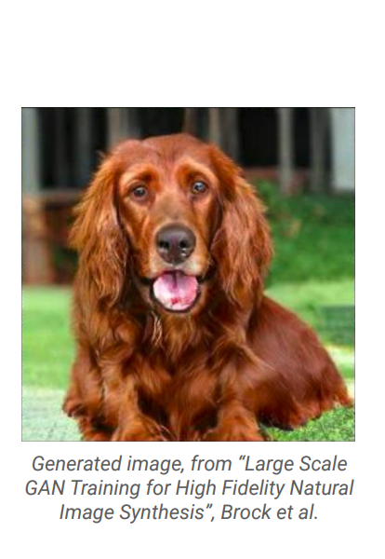
Self-Supervision
[Slide from Colin Raffel]
Notes:
Here's an example of an image produced by a recent generative model developed by some researchers at DeepMind.
The generative model has made up this dog completely on its own.
It has never seen this particular dog before in the training set, either.
To my eyes at least, it's hard to tell that this is a generated image and not a real picture of a dog.

Slide 9
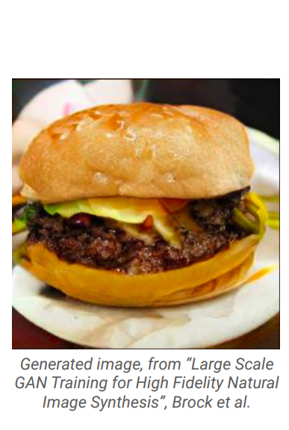
Self-Supervision
[Slide from Colin Raffel]
Notes:
And here's another one.
I for one would be happy to eat this made-up cheeseburger.
The fact that the model is able to produce these images suggests that it has learned about the structure of the natural world.
The model has done this without explicit supervision - it was simply shown millions of images and discovered this structure itself.

Slide 10
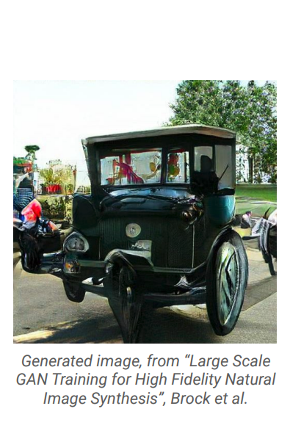
Self-Supervision
[Slide from Colin Raffel]
Notes:
Of course, this model is not perfect -- sometimes it generates things like this quasi-car.

Slide 11
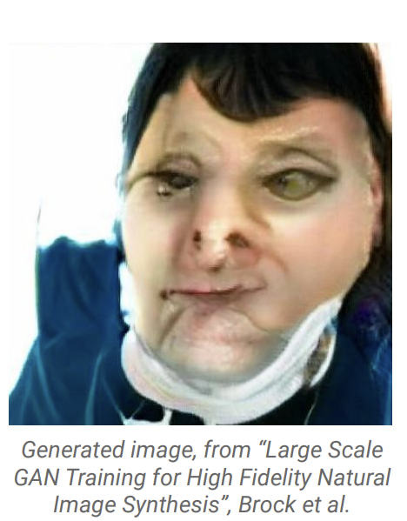
Self-Supervision
[Slide from Colin Raffel]
Notes:
Even worse, it hasn't really figured out what human faces look like.
This is likely because the dataset it was trained on has a relatively low proportion of images of people’s faces.
So while the results are quite impressive, there's still work to be done.

Slide 12
Self-Supervision
== treaty of paris (1763) the treaty of paris, also known as the treaty of 1763, was signed on 10 february 1763 by the kingdoms of great britain, france and spain, with portugal in agreement, after great britain's victory over france and spain during the seven years' war. the signing of the treaty formally ended the seven years' war, known as the french and indian war in the north american theatre, ….
[Slide from Colin Raffel]
Notes:
This same paradigm can be applied to other domains outside of natural images. For example, let's say we collect articles from Wikipedia.

Slide 13
Self-Supervision
== wheelbarrow
A wheelbarrow is a small hand-propelled vehicle, usually with just one wheel, designed to be pushed and guided by a single person using two handles at the rear, or by a sail to push the ancient wheelbarrow by wind. The term "wheelbarrow" is made of two words: "wheel" and "barrow." "Barrow" is a derivation of the Old English "barew" which was a device used for carrying loads. The wheelbarrow is designed to distribute the weight of its load between the wheel …
== treaty of paris (1763) the treaty of paris, also known as the treaty of 1763, was signed on 10 february 1763 by the kingdoms of great britain, france and spain, with portugal in agreement, after great britain's victory over france and spain during the seven years' war. the signing of the treaty formally ended the seven years' war, known as the french and indian war in the north american theatre, ….
[Slide from Colin Raffel]

Slide 14

Self-Supervision
== lemon
The lemon (Citrus limon) is a species of small evergreen trees in the flowering plant family Rutaceae, native to Asia, primarily Northeast India (Assam), Northern Myanmar or China.[2] The tree's ellipsoidal yellow fruit is used for culinary and non-culinary purposes throughout the world, primarily for its juice, which has both culinary and cleaning uses.[2] The pulp and rind are also used in cooking and baking. The juice of the lemon is about 5% to 6% citric acid, with a pH .…
== wheelbarrow
A wheelbarrow is a small hand-propelled vehicle, usually with just one wheel, designed to be pushed and guided by a single person using two handles at the rear, or by a sail to push the ancient wheelbarrow by wind. The term "wheelbarrow" is made of two words: "wheel" and "barrow." "Barrow" is a derivation of the Old English "barew" which was a device used for carrying loads. The wheelbarrow is designed to distribute the weight of its load between the wheel …
== treaty of paris (1763) the treaty of paris, also known as the treaty of 1763, was signed on 10 february 1763 by the kingdoms of great britain, france and spain, with portugal in agreement, after great britain's victory over france and spain during the seven years' war. the signing of the treaty formally ended the seven years' war, known as the french and indian war in the north american theatre, ….
Dataset of Wikipedia articles
[Slide from Colin Raffel]
Notes:
Once we have a large dataset of articles …

Slide 15
Self-Supervision
== lemon
The lemon (Citrus limon) is a species of small evergreen trees in the flowering plant family Rutaceae, native to Asia, primarily Northeast India (Assam), Northern Myanmar or China.[2] The tree's ellipsoidal yellow fruit is used for culinary and non-culinary purposes throughout the world, primarily for its juice, which has both culinary and cleaning uses.[2] The pulp and rind are also used in cooking and baking. The juice of the lemon is about 5% to 6% citric acid, with a pH .…
== wheelbarrow
A wheelbarrow is a small hand-propelled vehicle, usually with just one wheel, designed to be pushed and guided by a single person using two handles at the rear, or by a sail to push the ancient wheelbarrow by wind. The term "wheelbarrow" is made of two words: "wheel" and "barrow." "Barrow" is a derivation of the Old English "barew" which was a device used for carrying loads. The wheelbarrow is designed to distribute the weight of its load between the wheel …
== wings over kansas wings over kansas is the second studio album by jason ammons, john bolster and mo rosato. the album debuted at number one on the billboard 200, selling 35,000 copies in it first week at the time. it was the second highest selling album to debut at the billboard top 50 and the third highest selling album to debut at the top heatseekers, with 26,000 copies sold. this is the supremes album earning the nickname nitty gritty but their other two singles by the band in …
== treaty of paris (1763) the treaty of paris, also known as the treaty of 1763, was signed on 10 february 1763 by the kingdoms of great britain, france and spain, with portugal in agreement, after great britain's victory over france and spain during the seven years' war. the signing of the treaty formally ended the seven years' war, known as the french and indian war in the north american theatre, ….
Dataset of Wikipedia articles
[Slide from Colin Raffel]
Notes:
we can train a generative model to generate new Wikipedia articles.
In this example. the generated article discusses a made-up album called Wings over Kansas.
The model was only given the title of the article and filled in the rest.
You can see that the model has learned not only basic sentence structure, grammar, and spelling, but also the kind of content which is typical in Wikipedia articles.
It also stays on theme, though it does end up generating some nonsense near the end.

Slide 16
Self-Supervised Models
are predictive models of the world!

Slide 17
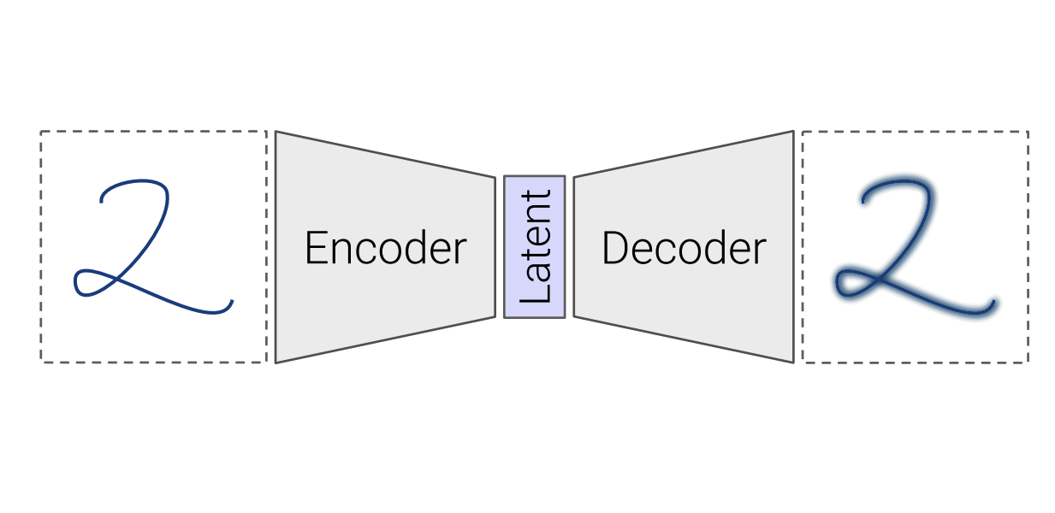
Self-Supervised Models
Are trained to complete partial samples from the world.
Mask
[Bengio et al. 2004, Hinton et al. 2006, Peters et al. 2018, …]
Notes:
These predictive models are trained to fill-in partial instances of the world. To make it a bit more concrete, …

Slide 18
Self-Supervised Models
“Wings over Kansas is an aviation website founded in 1998 by Carl Chance owned by Chance Communications, Inc.”
“Wings over Kansas is [MASK]”
[Bengio et al. 2004, Hinton et al. 2006, Peters et al. 2018, …]

Slide 19
Self-Supervised Models
Learned from cheaply available unlabeled data
Notes:
And to do this training effectively, essentially we're training them on...

Slide 20
Self-Supervised Models
Learned from cheaply available unlabeled data
Notes:
When I say “data” this is what I am talking about: a large collection of data, for instance freely available text documents, possibly with some structure that you get for free.

Slide 21
Self-Supervised Models
Learn from unlabeled data – a special case of unsupervised learning
Why not then call them “unsupervised”?
Notes:
In a way, self-supervised models are special case of “unsupervised” learning.

Slide 22
Self-Supervised Models
Why not then call them “unsupervised”?
Predictive models of the world are tightly connected to many tasks we care about*!
* Thus far

Slide 23
Self-Supervised Models and End Tasks
Goal: Answering questions
Question: “Where is the birthplace of the American national anthem?”
✍️
“The birthplace of the American national anthem, "The Star-Spangled Banner," lies in Baltimore, Maryland.”
“The birthplace of the American national anthem” [MASK]
Produced with GPT-J: https://6b.eleuther.ai/

Slide 24
Self-Supervised Models and End Tasks
Goal: Sentiment classification
Review: “While this restaurant is popular on Google, I absolutely disliked it.”
✍️
“We want to decide whether the sentiment of the review is "positive" or "negative".
Review: "While this restaurant is popular on Google, I absolutely disliked it".
The sentiment of this review is” [MASK]
“...is negative.”
Produced with GPT-J: https://6b.eleuther.ai/

Slide 25
Self-Supervised Models
Are representations of the world learned from unlabeled data in a while that the conveniently applicable end tasks.
Notes:
Putting all these together, we get this definition: …
This was my definition of self-supervised models.

Slide 26
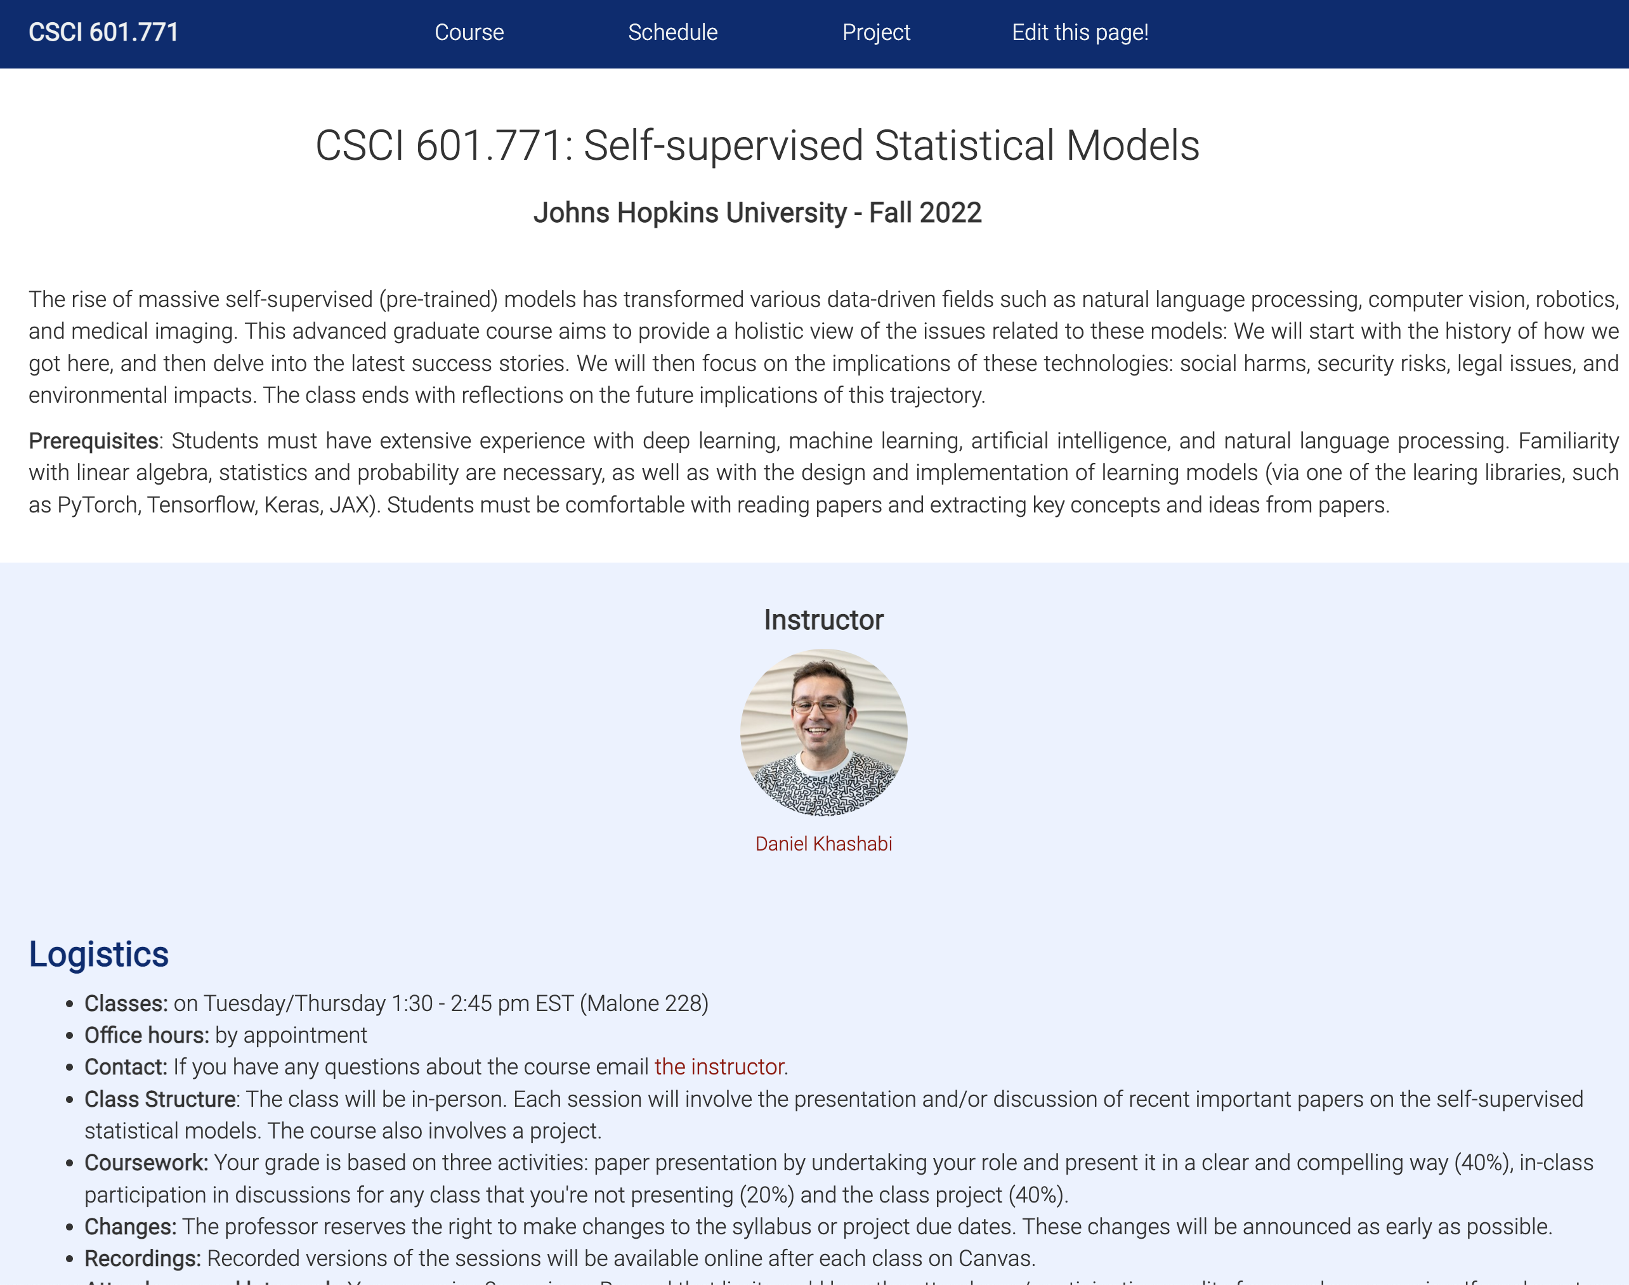
Self-Supervised Models: Course Website
https://self-supervised.cs.jhu.edu
Notes:
Now that we have defined what ”self-supervised models” let’s what’s in this class.

Slide 27
Self-Supervised Models: Topics
Self-supervised models for language, vision, audio/speech, etc.
What models are available?
What architectures are these based on?
How are these models trained?
What are the capabilities?
What are their weaknesses?

Slide 28
Self-Supervised Models: Topics
Self-supervised models for language, vision, audio/speech, etc.
Behavior change as a function of scale

Slide 29


Scaling
Larger pre-training datasets
cheap freely-available text
1GB
10GB
10TB

Slide 30
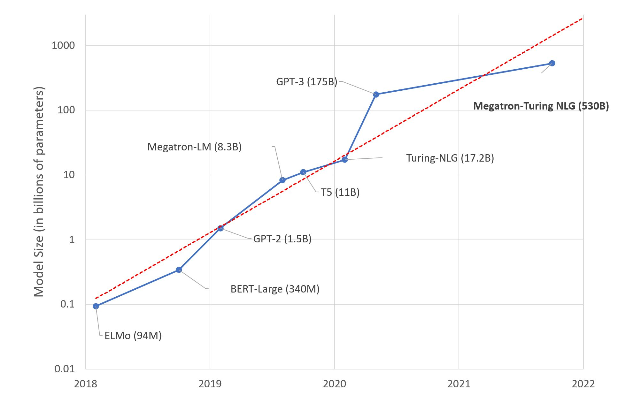
Scaling
Larger pre-training datasets
Larger models
Notes:
There has also been progress

Slide 31
Self-Supervised Models: Topics
Self-supervised models for language, vision, audio/speech
Behavior change as a function of scale
What is really the nature of “scale”?
How does the quality change with scale? (end tasks, biases, etc.)
How efficiently can we scale?
In an ideal limit, how far will scale lead to benefits?
Is scale the right “hill” to climb? (Should we really scale?!)

Slide 32
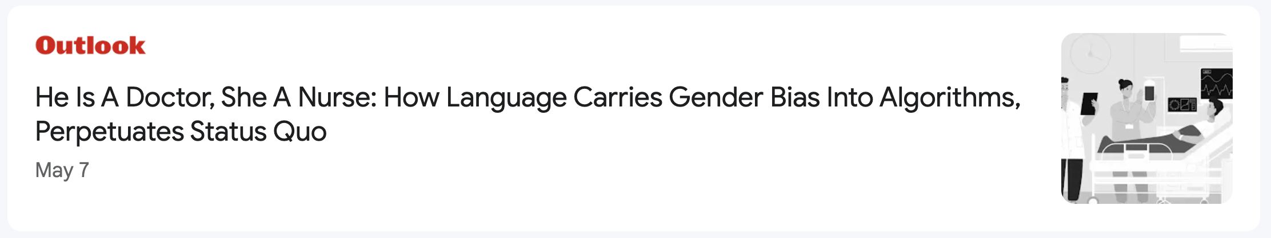
Self-Supervised Models: Topics
Self-supervised models for language, vision, audio/speech
Behavior change as a function of scale
The problematic content: bias, toxic language, etc.

Slide 33
Self-Supervised Models: Topics
Self-supervised models for language, vision, audio/speech
Behavior change as a function of scale
The problematic content: bias, toxic language, etc.
Environmental impacts

Slide 34
Self-Supervised Models: Topics
Self-supervised models for language, vision, audio/speech
Behavior change as a function of scale
The problematic content: bias, toxic language, etc.
Environmental impacts
The future of these models and their impacts on our lives

Slide 35
A Bias …
Most of the class revolves around natural language.

Slide 36
Why Natural Language?
It is a convenient medium of communication.
Natural language is our species’ best attempt to encode everything about the world as efficiently as possible.
A huge quantity of writing is freely available on the internet.
Notes:
So, if you’re taking this class, please be prepared to read and hear a lot about language.
That being said, there will be sessions that we will dedicate to vision or speech, though not the majority of our time.

Slide 37
What We Will Not Cover
Multilinguality & Cross-linguality → see Kenton Murray’s class
Multi-step decision-making, dialogue → see Ben Van Durme’s class
Actively learning
Human-in-loop
Data augmentation
….

Slide 38
What I Expect You
Comfortable with machine learning.
Modeling: linear models, classification, neural networks
Training: gradient descent, backpropagation, train/test/dev splits
Measuring quality: generalization: overfitting vs underfitting
Familiarity with NLP is helpful, though not necessary.
Being open to reading [somewhat esoteric] papers and presenting their gist to the class.

Slide 39
Questions so far?

Slide 40
Class Structure
The class will be in-person.
Each session will involve the presentation/discussion of a recent important paper on self-supervised models.
The course also involves a project.

Slide 41
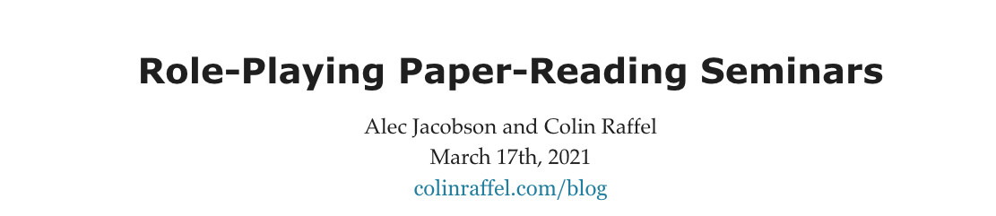
Class Presentations
Role-based presentation
https://colinraffel.com/blog/role-playing-seminar.html

Slide 42
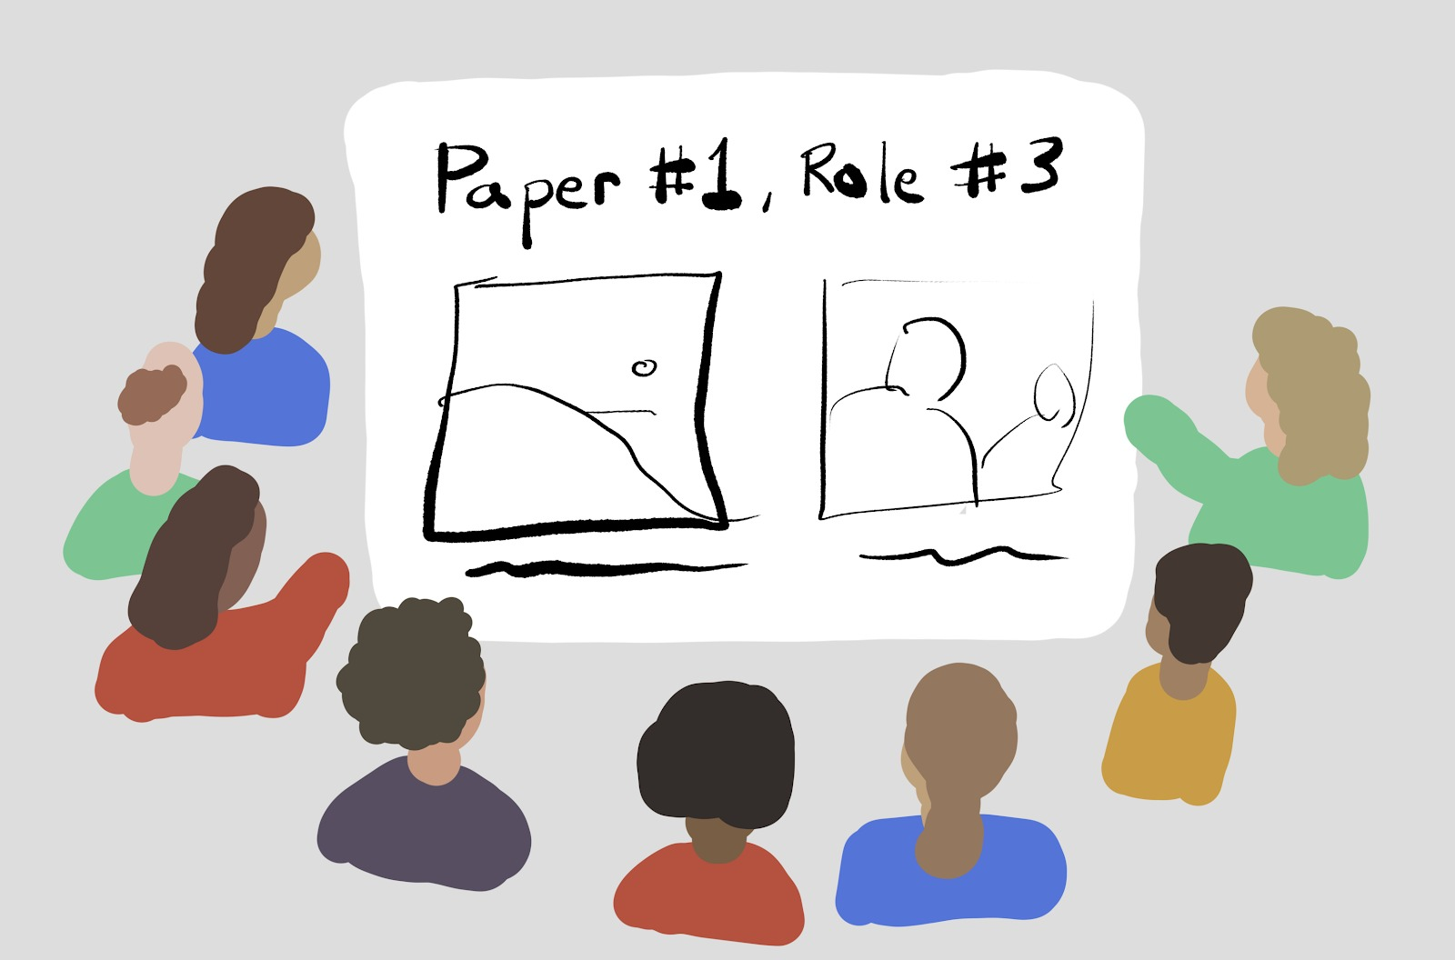
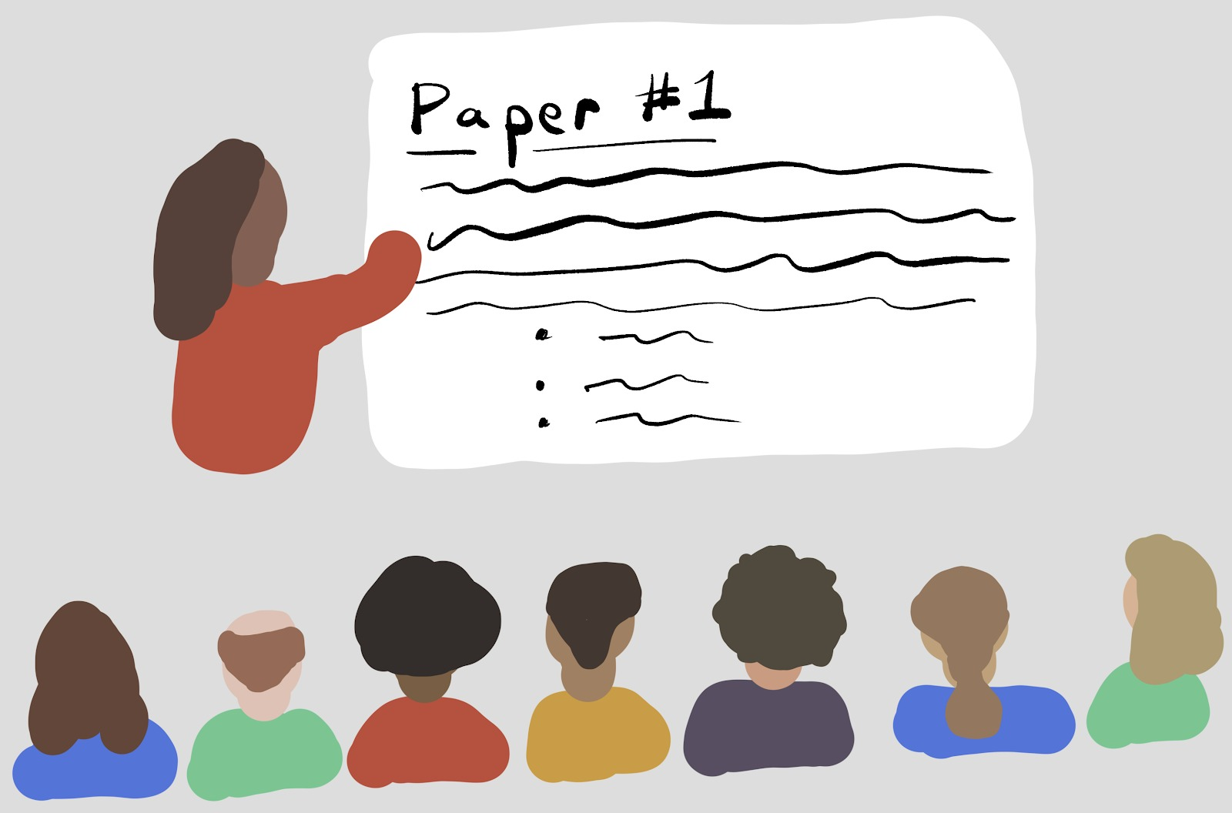
Role-based presentation vs.
Many students cooperatively present a paper.
Each subgroup of students takes a specific “role”.
The “role” defines the lens through which you read/present a paper.
One-to-Many presentations
A single (subgroup of) student(s) presenting a paper to the class.
Pro:
Easy division of labor
Cons:
Too much work for one person
Audience easy to disengage
Notes:
This is as opposed to …
Pro:
…
Con:
Each person’s presentation might happen once or twice each term, though …
It is easy for students to disengage during the presentations of papers for which they are merely audience members.
This results in their missing out on a large position of the course's content.
As the term progresses presenter-students may themselves devolve into offering only shallow summaries of the selected paper void of critical analysis.

Slide 43
Role-based presentation
Many students cooperatively present a paper.
Each subgroup of students takes a specific “role”.
One-to-Many presentations
A single (subgroup of) student(s) presenting a paper to the class.
Pro:
Easy division of labor
Cons:
Too much work for one person
Audience easy to disengage
Role: Stakeholder ✍️
Act as if you're the author of this paper. Try to sell it!

Slide 44
Role-based presentation
Many students cooperatively present a paper.
Each subgroup of students takes a specific “role”.
One-to-Many presentations
A single (subgroup of) student(s) presenting a paper to the class.
Pro:
Easy division of labor
Cons:
Too much work for one person
Audience easy to disengage
Role: Scientific Reviewer 🔎
Do a complete conference-style critical peer-review of the paper.

Slide 45
Role-based presentation
Many students cooperatively present a paper.
Each subgroup of students takes a specific “role”.
One-to-Many presentations
A single (subgroup of) student(s) presenting a paper to the class.
Pro:
Easy division of labor
Cons:
Too much work for one person
Audience easy to disengage
Role: Empiricist 👩🏽‍🔬
Implement something related to the paper and your finding and code with the class.

Slide 46
Role-based presentation
Many students cooperatively present a paper.
Each subgroup of students takes a specific “role”.
One-to-Many presentations
A single (subgroup of) student(s) presenting a paper to the class.
Pro:
Easy division of labor
Cons:
Too much work for one person
Audience easy to disengage
Role: Archaeologist 🏺
Determine the [prior and recent] literature that inspired and was inspired by this work.

Slide 47
Role-based presentation
Many students cooperatively present a paper.
Each subgroup of students takes a specific “role”.
One-to-Many presentations
A single (subgroup of) student(s) presenting a paper to the class.
Pro:
Easy division of labor
Cons:
Too much work for one person
Audience easy to disengage
Role: Visionary 🔭
Propose an imaginary follow-up -- research project or a new application.

Slide 48
Role-based presentation
Many students cooperatively present a paper.
Each subgroup of students takes a specific “role”.
Students rotate “roles” each week.
One-to-Many presentations
A single (subgroup of) student(s) presenting a paper to the class.
Pro:
Easy division of labor
Cons:
Too much work for one person
Audience easy to disengage

Slide 49
Role-based presentation
Many students cooperatively present a paper.
Pro:
More engagement
Distributed and less workload
Present more frequently (once a week) 😭
Cons:
Need to manage role assignment
One-to-Many presentations
A single (subgroup of) student(s) presenting a paper to the class.
Pro:
Easy division of labor
Cons:
Too much work for one person
Audience easy to disengage
Present a 1-2 times only.
Notes:
My expectation is that having students role-play in this way
makes them engage much more deeply with the papers, and maintain that engagement throughout the term,
and provides explicit opportunities to develop important skills that they otherwise would have no formal instruction on.

Slide 50
Role-Based Presentation
You will be split into two halves:
One half presenting on Tuesdays and the other on Thursdays.
Each member of the presenting half will be given a random role every week.
Each role has a time budget:
18 mins for Stakeholder ✍️
12 mins for the rest of the roles

Slide 51
Questions so far?

Slide 52
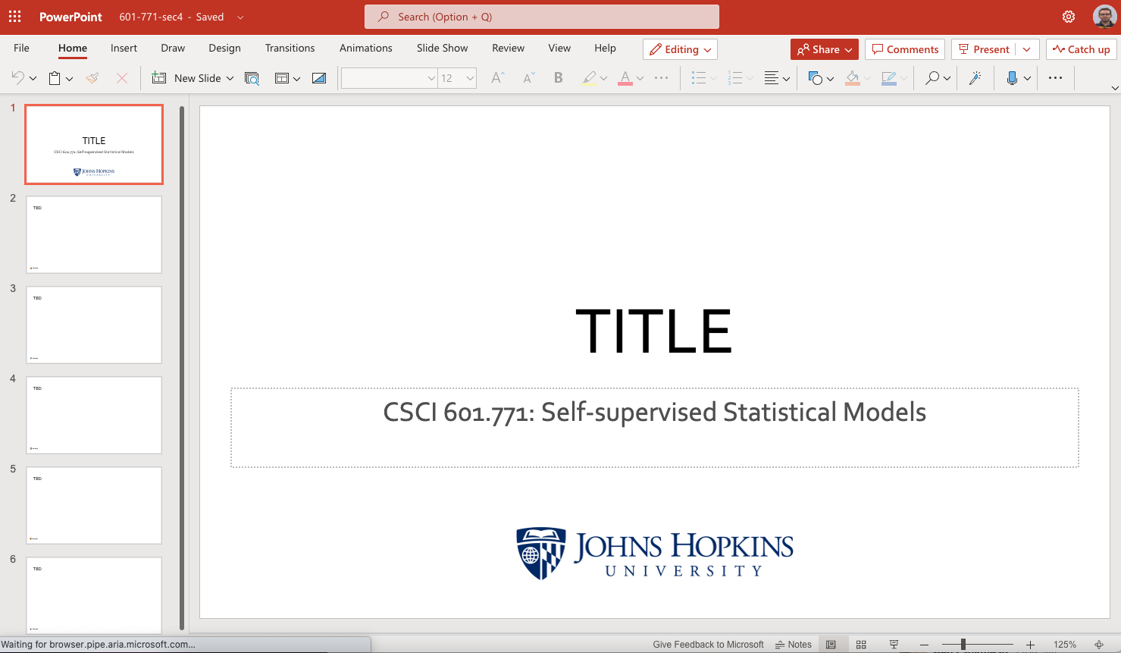
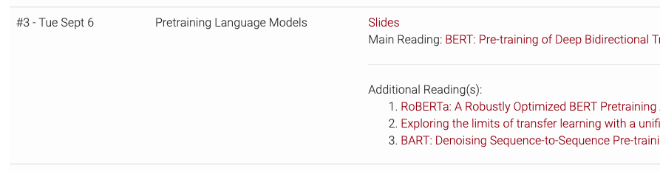
Slides?
Using slides is encouraged though optional.
A shared pool of slides (links accessible on the class website).
https://self-supervised.cs.jhu.edu

Slide 53
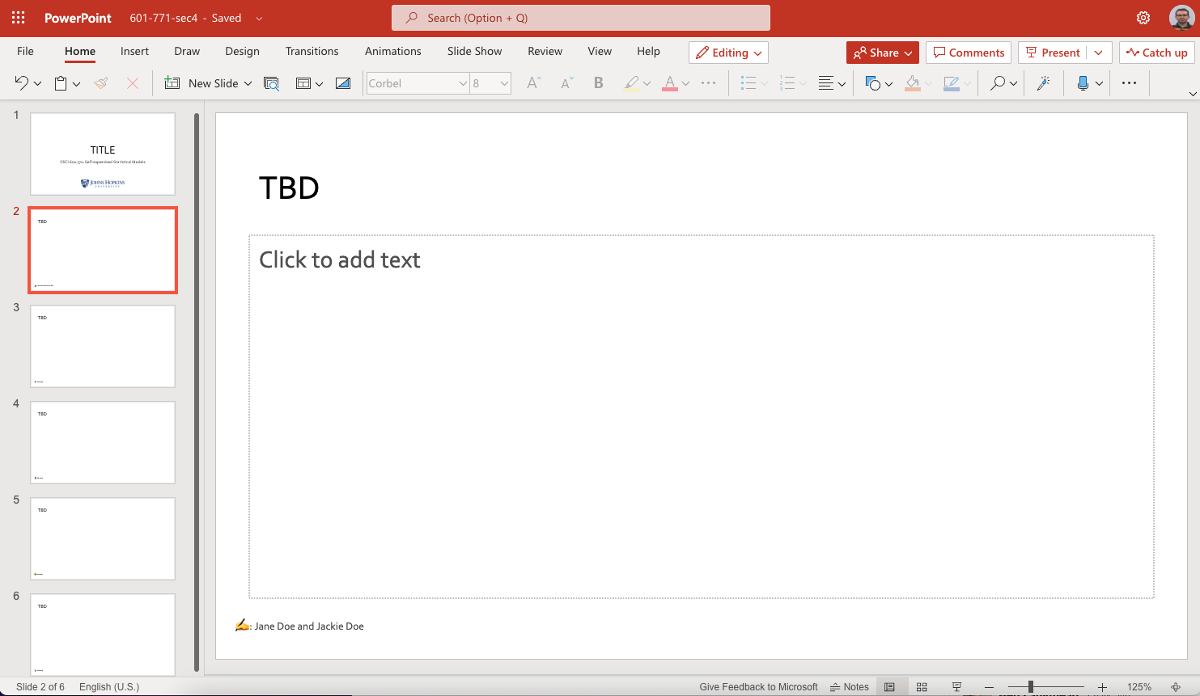
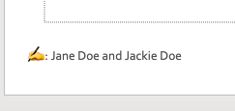
Slides?
Using slides is encouraged though optional.
A shared pool of slides (links accessible on the class website).
https://self-supervised.cs.jhu.edu

Slide 54
Non-presenter Activity
Before the class: a short answer to a prompt. For example,
“An alternative title for this paper is _____”
“My least favorite thing about this paper is _____”
Beginning of each class: one question about the paper
Something you're confused about or something you'd like to hear discussed more.
During the class: come to class ready to participate in the discussions.

Slide 55
Class Engagement
You have the freedom (and encouraged) to share your concerns, questions or suggestions, while being respectful.
I hope this class will be an open and safe space for class discussions.
Remember to Step Up & Step Back.
Notes:
This means, if you are the person who feels very comfortable sharing, take note of how often you are sharing, and consider giving time for for others to share.
By all means, be present and active in this conversation, but make sure others have the time to as well.
If you tend to be a quiet participant, take a chance and “step up” with your idea, share your concerns, your ideas, concerns, and excitement with the group.

Slide 56
Attendance
You can miss 3 sessions. Drop me a note before the class.
If you’re ”non-presenting”, that’s easy!
If you’re ”presenting”, that’s a bit complicated:
Find someone willing to swap presentations with.
Create the presentation for that role and find someone else to present.
If you have any COVID symptoms, skip the class.
Does not count toward your 3 sessions.
Drop me a note before the class.
Notes:
Students who report symptoms associated with COVID-19 are expected not to attend class

Slide 57
Class Project
One project for the whole class.
Groups of size 2 or 3. You can start looking now! 😭
The topic is open-ended.
Examples,
demonstrating systemic limitations of prior work,
suggesting improvements on methods or benchmarks discussed in the class, and so on.
If you want to chat/brainstorm about it, shoot me an email.
Check the course page for the project deadlines.
Notes:
Students in groups are required to include a “contributions” section concretely lists each auth

Slide 58
Your Grade
It’s a function of three items:
Paper presentation (33%)
In-class participation (33%)
Class project (33%)
Bonus point (1%)
If you’re engaged in class presentations and on top of your project, you should not be worried about the grade.

Slide 59
Last call for questions! 📢

Slide 60
Question for You
What is the best medium of communication for us? (Slack? Email? Canvas?)
Announcements, role assignments, cancellations, broad discussions, etc.
How can I/we make this a better learning environment for each other?
How many people have [used/read the paper for] X?
Notes:
BERT
GPT3
OPT
in-context learning
Encoder-decoder
T5
Causal language model
Dall-E

